Slide 1

Health Goals
Software Engineering (332:452)
Group Number: 1
Demo Date: April 23, 2019
Group Members:
Anushka Desai
Varun Bhandari
Niharika Mishra
Sai Singanamala
Arti Patel
Kishan Patel
Jose Cuentas
Varun Raghuraman

Slide 2

Presentation Roadmap
Project Overview & Goals
Live Demo
Focus on significant features & functionality
Brief overview of all other pages
Web Development
Research
Backend
Final Product!

Slide 3

Project Overview
Our Goals:
Provide a personal health social media site for users interested in monitoring and improving their mental and physical health
Address problem of users who want one source of information relating to their health goals
Cultivate dependable and personalized sources of information such as articles and other resources for users

Slide 4
Project Overview cont.
Our Audience:
Users: users with accounts will be able to participate in group chats, leaderboards, and received personalized information based on their profiles
Visitors: users without accounts can still access information such as wellness articles, fitness articles and recipes using different search filters

Slide 5
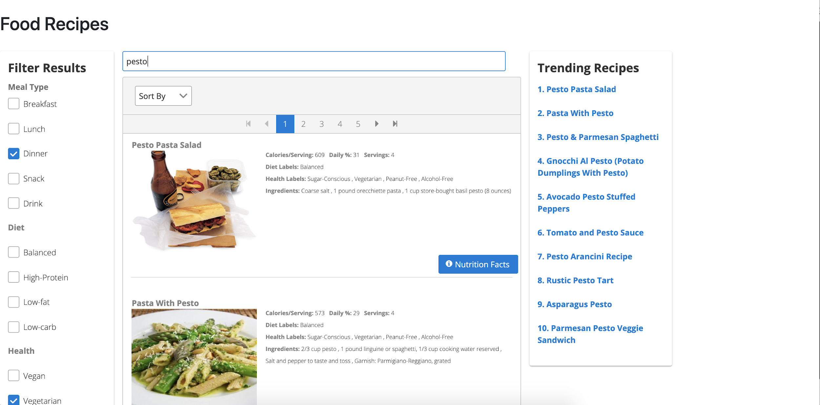
Key Features/Functions
Function #1: Search Recipes
Both the user and visitor should be able to successfully navigate our site and interact with the various features. The user will have more personalization in their searches.
Search Recipes
Search for recipe articles by typing in key word queries
Use search filters to narrow down results
Useful for users who want to find healthy recipes with their exact specifications

Slide 6
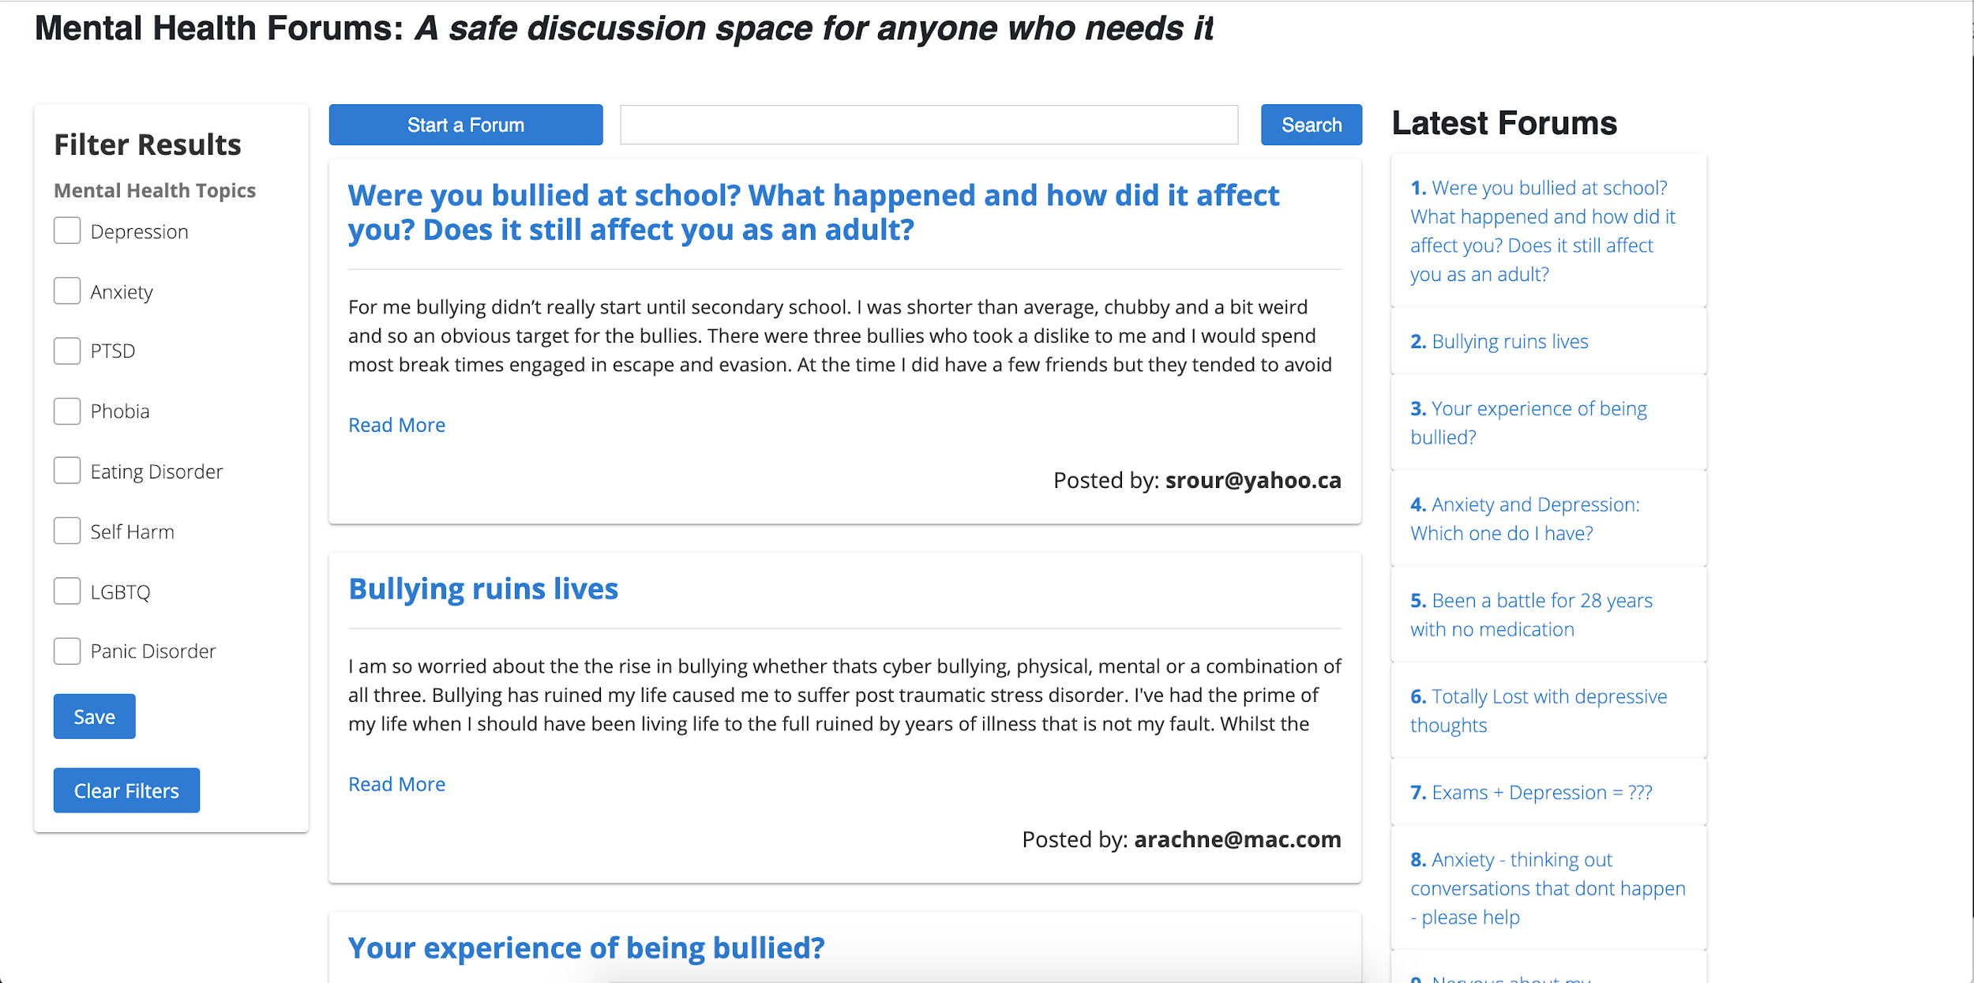
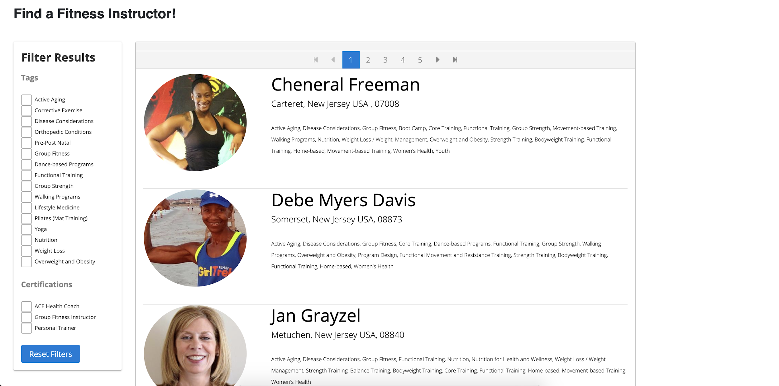
Key Features/Functions
Function #2: Mental Health Forums
Function #3: Find Instructors
List group of mental health services that are nearby that users may find helpful
Allow use of filters to view customized results
Useful for users in need of connecting with others over similar issues
Search through local database of fitness instructors
Filter through instructors based on training types and certifications

Slide 7
Thank you!

